Slide 1


Enhancing Fake News Detection with Hybrid NLP
Student Name : Sabareesh M(211423104549)
Ranjith C (211423104525)
Guide Name : Dr. Prabbu Sankar
Co-Ordinator : Dr. Kadirvelu
Batch Number : H27
SDG Goal : SDG 9 - Industry, Innovation, and Insfrastructure

Slide 2
ABSTRACT
Fake news has become a serious challenge in the digital age, spreading rapidly across social media platforms and misleading the public. This project proposes a smart system for detecting fake news using Natural Language Processing (NLP) and Machine Learning (ML) techniques. The system analyzes news articles and classifies them as real or fake based on their textual content.In addition to traditional methods like TF-IDF and Logistic Regression, the project introduces five new features to improve accuracy and user engagement: (1) Author Trust Score, (2) Real-Time Google Fact-Check, (3) Sentiment Analysis, (4) Title–Body Mismatch Detection, and (5) Writing Style Check.. This solution supports the United Nations Sustainable Development Goals (SDGs), especially SDG 16 (Peace, Justice, and Strong Institutions) and SDG 4 (Quality Education), by promoting access to truthful information and encouraging digital literacy.

Slide 3
INTRODUCTION
In today’s digital world, social media and online platforms have become the primary sources of news for millions of people. However, along with genuine information, a large amount of fake news is also spreading rapidly, which misleads society and creates serious problems. Detecting and preventing the spread of fake news has become a major challenge. Our project aims to address this issue by developing a Fake News Detection System using Natural Language Processing (NLP) techniques and Machine Learning algorithms. By analyzing the text of news articles, the system can classify whether the given news is real or fake. This system enhances the reliability of online information, promotes digital awareness, and helps users make informed decisions. It contributes to building a safer and more trustworthy digital media environment.

Slide 4
PROBLEM STATEMENT AND OBJECTIVES
Problem Statement:
Fake news spreads rapidly across social media and online platforms.
Many users share false information without checking its authenticity.
This creates confusion, misinformation, and affects public trust.
Objectives:
To design a system that automatically detects and classifies fake news.
To use Natural Language Processing (NLP) and Machine Learning techniques.
To help users identify reliable information quickly.
To reduce the impact of misleading content online.
To promote awareness and responsible digital communication.

Slide 5
LITERATURE REVIEW
Many researchers have developed different techniques to detect fake news using Machine Learning and Natural Language Processing (NLP). Earlier studies used traditional models like Logistic Regression and Naïve Bayes for text classification. Later, advanced deep learning models such as LSTM and BERT improved accuracy by understanding the meaning of words and context. These research works helped us understand how language patterns can identify fake news and inspired our project to build a more accurate and hybrid NLP-based system.

Slide 6
SOFTWARE/HARDWARE REQUIREMENT
SOFTWARE REQUIREMENTS
Operating System: Windows 10/11
Programming Language: Python 3.8+
Libraries: Flask, Scikit-learn, NLTK/SpaCy
IDE/Tools: VS Code
Database: CSV Files
HARDWARE REQUIREMENTS
Processor: Intel i3 or Higher
RAM: Minimum 4GB
Storage: 500 MB or Free Space
Internet Connection: Required for Setup

Slide 7
DATA COLLECTION
The dataset used in this project was gathered from trusted online news sources and publicly available fake news datasets. It contains a large number of real and fake news articles with their titles, content, and labels that indicate whether the news is genuine or misleading. This balanced dataset helps the model understand the difference between truthful and false information through language patterns. The collected data is cleaned, organized, and then divided into training and testing parts to build and evaluate the fake news detection system accurately.

Slide 8
EXISTING AND PROPOSED SYSTEM
Existing System:
Websites like Snopes or PolitiFact have people who check if the news is true or false. Facebook and Twitter use computer programs to find and hide fake news. Some computer programs learn from real and fake news examples.They read news text and decide if it’s true or fake.
Proposed System:
Author Trust Score: Checks how often the author posted fake news.
Google Fact-Check: Adds a button to let users search the news.
Sentiment Analysis: Finds out if the article is emotional or angry.
Title vs Content Matching: Checks if the title matches the actual story

Slide 9
METHODOLOGY & WORKFLOW
The project follows a structured process to detect fake news effectively.
Collect a dataset containing real and fake news articles.
Preprocess the data by removing noise, stop words, and unwanted symbols.
Apply NLP techniques to extract key features from the text.
Train Machine Learning models using the extracted features.
Classify the news as real or fake based on model predictions
Evaluate performance using metrics like accuracy and precision.

Slide 10
ALGORITHM USED
The project uses a hybrid approach combining Machine Learning and NLP techniques.
Text data is processed using TF-IDF and Word2Vec to convert words into numerical form.
Logistic Regression is used for simple and fast classification.
BERT model helps understand the deeper meaning of words and context.
The combination of these algorithms improves accuracy and reliability in detecting fake news.

Slide 11
LITERATURE REVIEW
1. Kaliyar, R. K., Goswami, A., & Narang, P. (2021)
Proposed FakeBERT, a BERT-based deep learning model for fake news detection.
Achieved higher accuracy compared to traditional ML models.
2. Zhou, X., & Zafarani, R. (2020)
Reviewed various fake news detection techniques on social media.
Discussed linguistic, network-based, and deep learning approaches.
3. Shu, K., Sliva, A., Wang, S., Tang, J., & Liu, H. (2017)
Studied the role of propagation patterns in detecting misinformation.
Highlighted the importance of combining content and social context.
4. Ahmed, H., Traore, I., & Saad, S. (2017)
Used classical ML algorithms (SVM, Decision Tree, Naïve Bayes).
Focused on extracting features like word frequency, n-grams.

Slide 12
SYSTEM DESIGN
Input Layer – User enters a news article or text in the web app.
Preprocessing Module – Cleans text using tokenization, stop word removal, and lemmatization.
Feature Extraction – Converts text into numeric vectors for training.
Classification Model – Uses ML or DL algorithms to detect real or fake news.
Output Layer – Displays the final result to the user clearly.

Slide 13
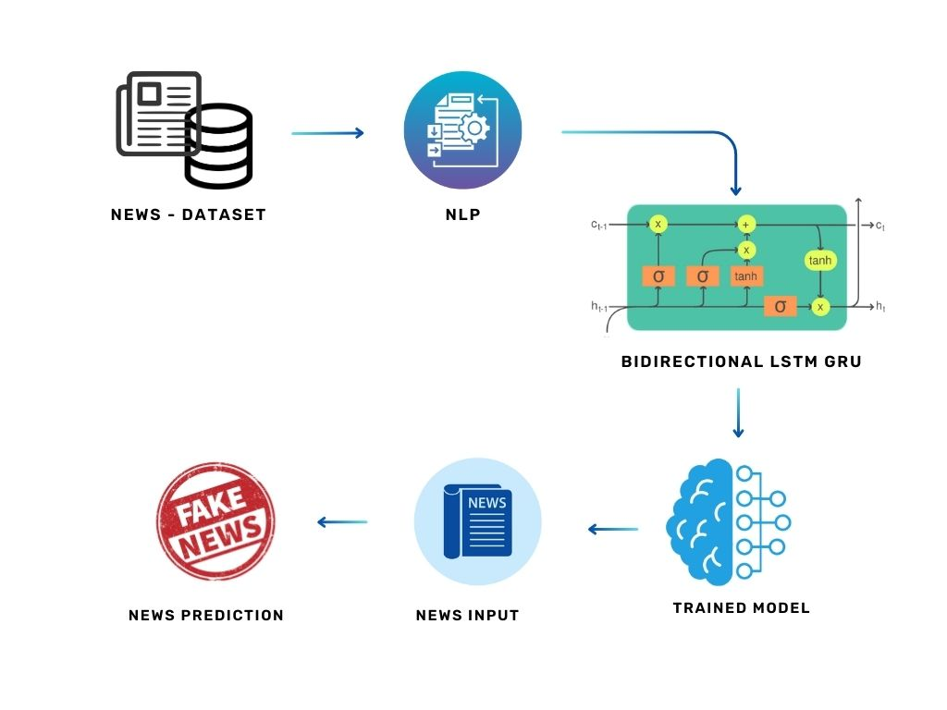
ARCHITECTURE DIAGRAM

Slide 14
IMPLEMENTATION
import streamlit as st
import google.generativeai as genai
genai.configure(api_key="YOUR_API_KEY")
model = genai.GenerativeModel("gemini-1.5-flash")
st.title("Fake News Detector")
text = st.text_area("Enter news text:")
if st.button("Analyze"):
st.write(model.generate_content([f"Is this news fake or real? {text}"]).text)

Slide 15
PERFORMANCE COMPARISON
The performance of different models is compared using metrics like accuracy, precision, recall, and F1-score.
Hybrid NLP model gives better results than traditional Machine Learning models.
The use of BERT embeddings improves understanding of text and context.
The model achieves high accuracy in detecting both real and fake news.
Results show that combining ML and NLP methods gives the best overall performance.

Slide 16
RESULTS AND PERFORMANCE EVALUATION
The system was tested using a real-world dataset containing both real and fake news articles.
The model accurately analyzed and classified news data using NLP and Machine Learning.
It learned key linguistic patterns and word relationships to detect fake content.
Evaluation metrics such as accuracy, precision, recall, and F1-score showed strong performance.
Results proved that the hybrid NLP model effectively distinguishes between real and fake news.
The system is efficient, reliable, and suitable for real-time fake news detection.

Slide 17
TESTING
Test Data Preparation
Different sets of news articles are collected, including verified real news and intentionally created fake news, to ensure diverse coverage.
Model Evaluation
The system processes each news sample, and its predictions are compared against the actual labels to measure accuracy, precision, and reliability.
Performance Analysis
Results are analyzed to identify strengths and weaknesses, check for consistent performance across topics, and ensure robustness in real-world scenarios.

Slide 18
APPLICATIONS AND REAL-WORLD IMPACT
Used by news agencies, social media platforms, and government organizations to detect fake news.
Helps people trust online information by filtering false content.
Promotes digital literacy and builds a safe online environment.
Useful for fact-checking websites and awareness campaigns.
Ensures that only authentic and verified news reaches the public.

Slide 19
CONCLUSION AND FUTURE ENHANCEMENT
.
Conclusion:
This project successfully demonstrates the detection of fake news using NLP and machine learning techniques. The model can effectively classify news as real or fake, providing a reliable tool for users to assess news authenticity and reduce misinformation in digital media.
Future Enhancement:
Multi language news detection
Real-time social media monitoring
Integration with fact-checking APIs
Use advanced deep learning models for better accuracy

Slide 20
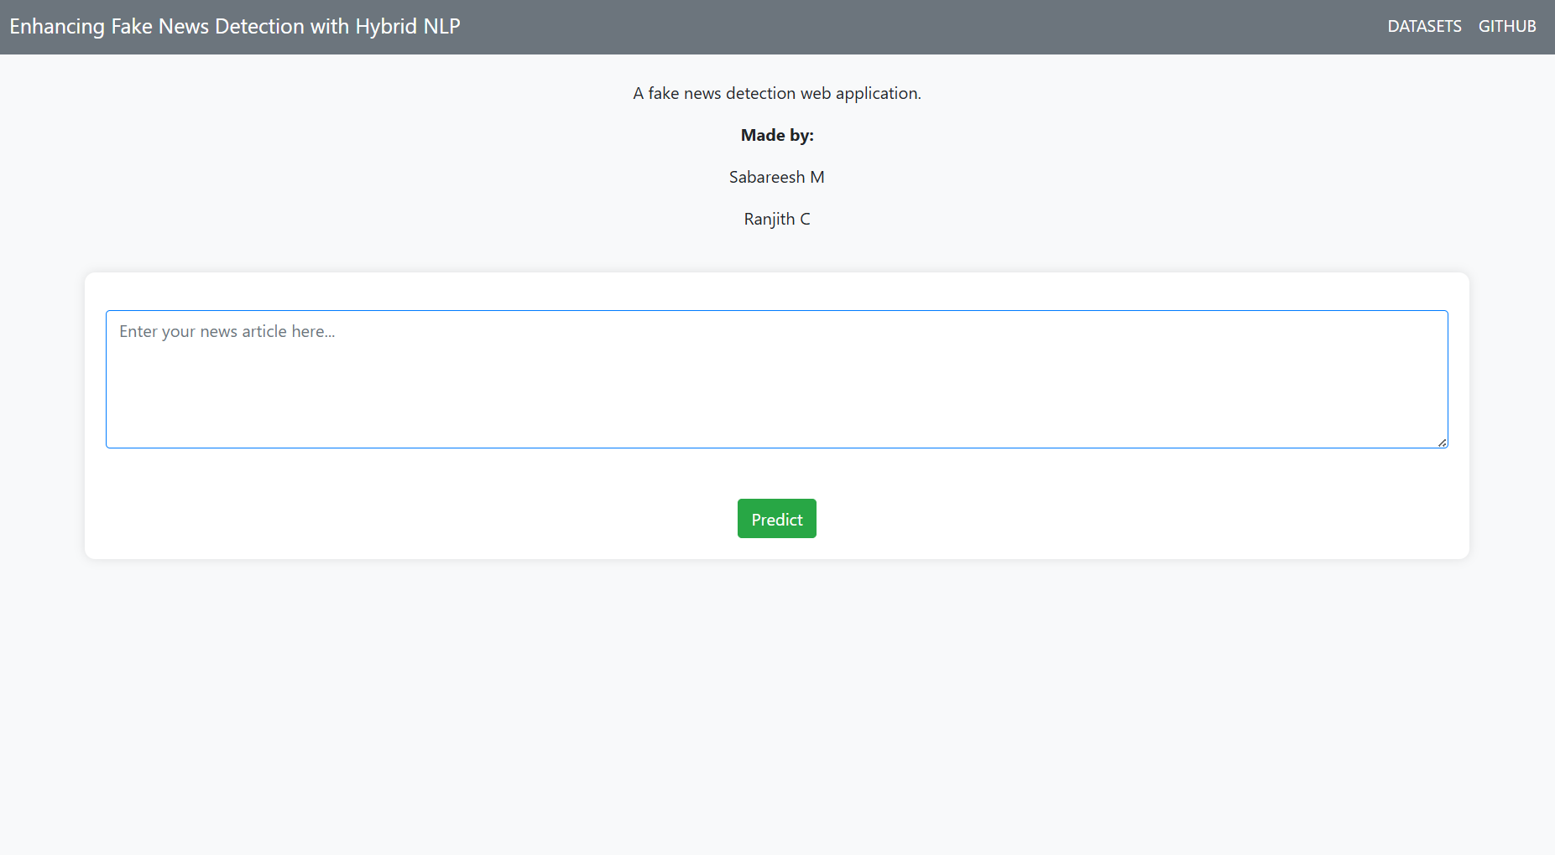
SCREENSHOT OF OUTPUT

Slide 21
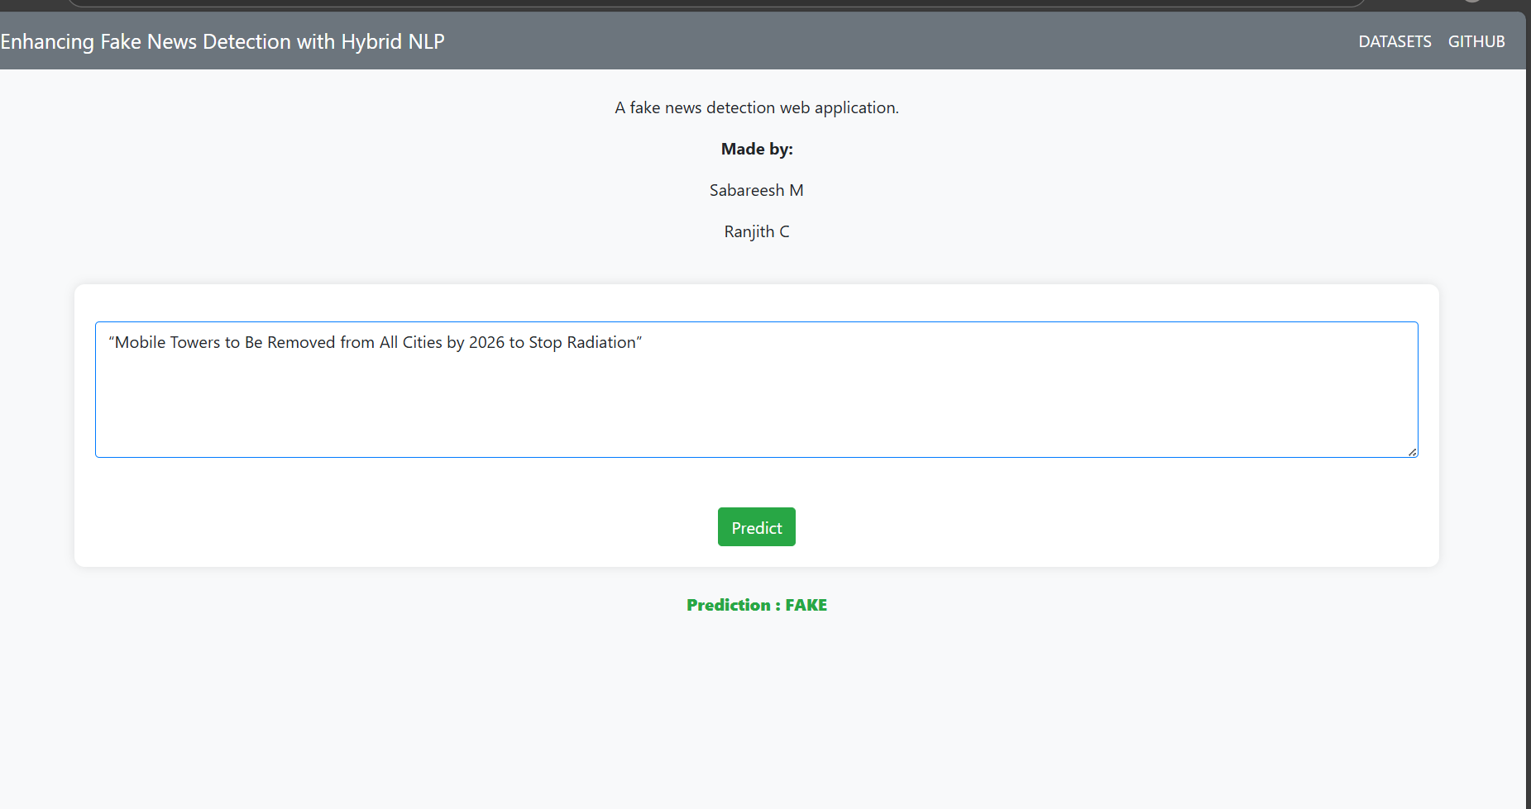

Slide 22
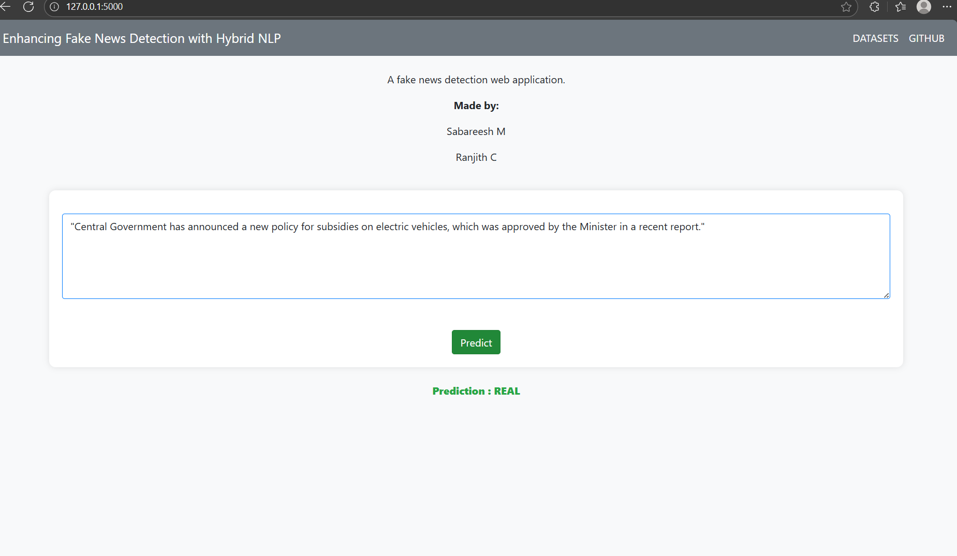

Slide 23
REFERENCE
Kaliyar, R.K., Goswami, A., & Narang, P. (2021). FakeBERT: Fake news detection in social media with a BERT-based deep learning approach. Multimedia Tools and Applications, 80(8), 11765–11788.
Alshuwaier, F.A. (2025). Fake News Detection Using Machine Learning and Deep Learning. Information, 14(9), 394.
Shu, K., Sliva, A., Wang, S., Tang, J., & Liu, H. (2017). Fake News Detection on Social Media: A Data Mining Perspective. ACM SIGKDD Explorations Newsletter, 19(1), 22–36.
Oshikawa, R., Qian, J., & Wang, W.Y. (2018). A Survey on Natural Language Processing for Fake News Detection. arXiv:1811.00770.
Alghamdi, J., & Alghamdi, A. (2024). A novel semantic deep learning approach to fake news detection. Expert Systems with Applications, 207, 118070.

Slide 24
PUBLICATION DETAILS
Title: FakeBERT: Fake news detection in social media with a BERT-based deep learning approach
Authors: Rohit Kumar Kaliyar, Anurag Goswami, Pratik Narang
Journal: Multimedia Tools and Applications
Volume/Issue: 80(8), Pages 11765–11788
DOI: 10.1007/s11042-020-10183-2
Year: 2021

Slide 25
THANK YOU

